Slide 1


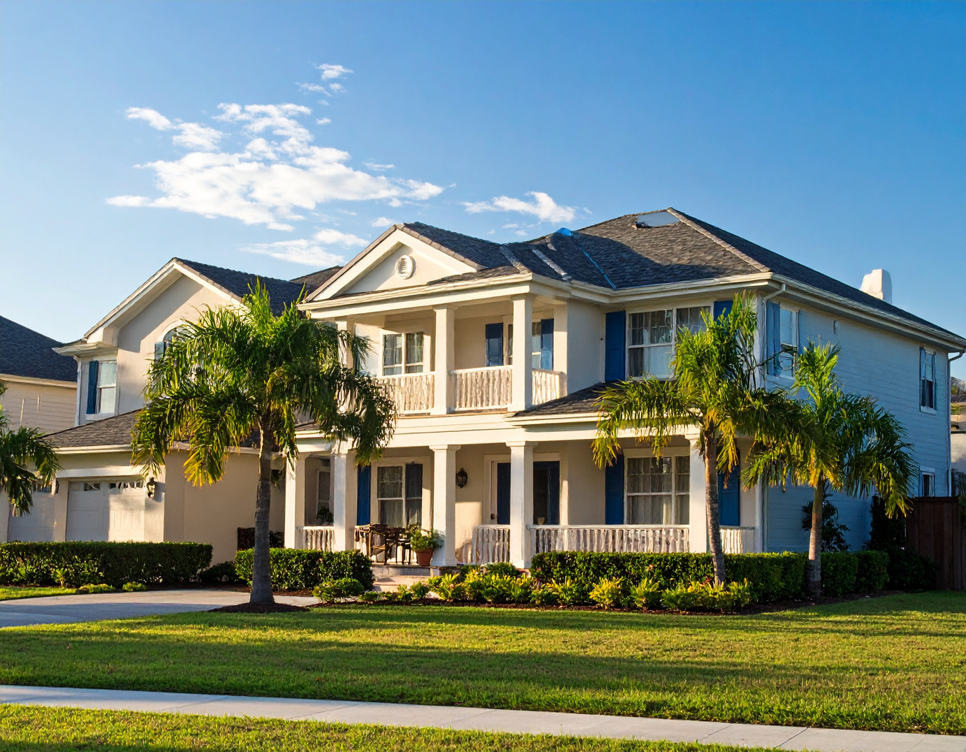

Profitable Property Flipping in
Florida
Your Path to Higher Returns with Trusted Realtor,
Thomas Valiyaveedan

Slide 2



About Me
Meet Your Realtor:
Thomas Valiyaveedan
25+ years of trusted real estate experience
Expert in Florida property market dynamics
Proven success with property flipping
Strong commitment to transparency and
client satisfaction

Slide 3


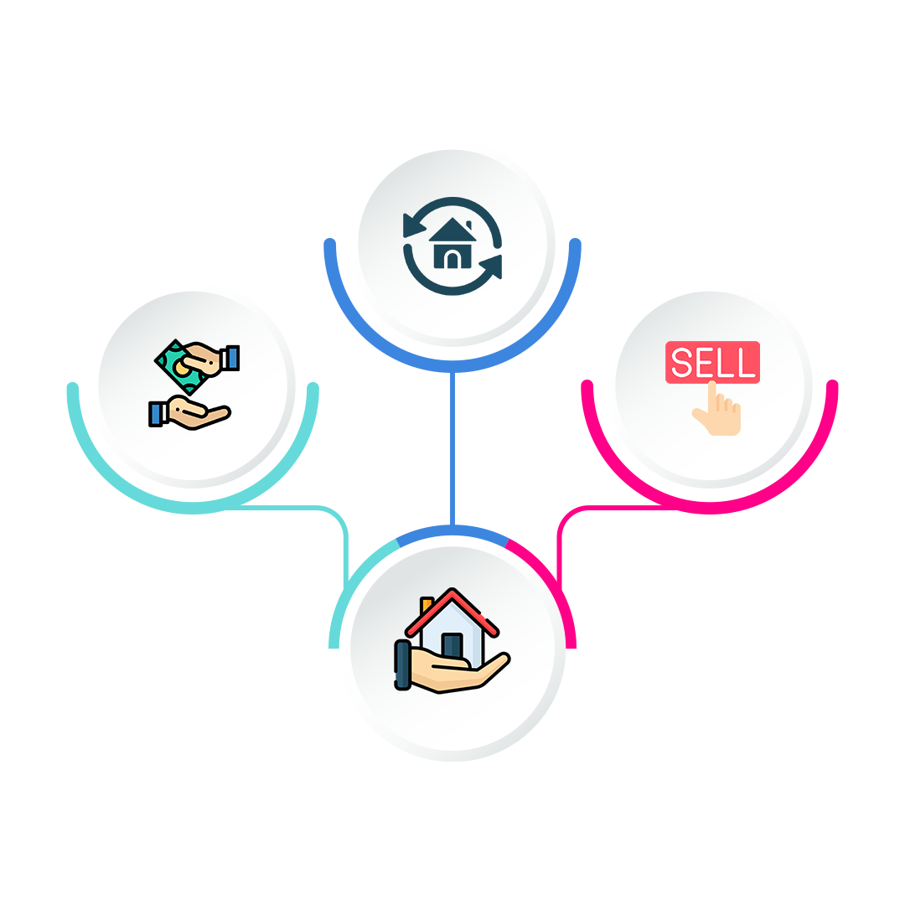
Why Property Flipping?
Buying properties below market value from wholesalers.
Renovating strategically for maximum appreciation.
Fast, profitable resale within 3-4 months.
Historically proven method to build wealth rapidly.

Slide 4

Our Unique Advantage: CMA
Maximizing Profits Through Comparative Market Analysis (CMA)
Precise analysis ensures profitable buying decisions.
Avoids overpaying, maximizing investment returns.

Slide 5


Investor-Friendly Process
Simplified investment: Sign, fund, relax.
Realtor handles acquisition, renovation, and resale.
Complete transparency throughout the process.

Slide 6


Two Simple Financing Methods
Flexible Financing Options
Cash Investment: Quick and direct method.
Hard Money Loan: Ideal if preferring to
leverage finances.

Slide 7

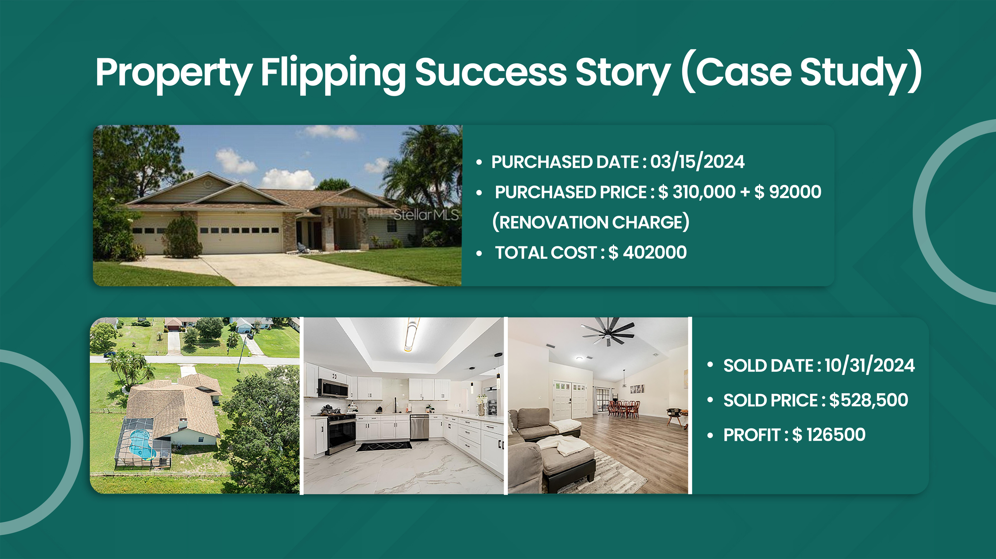

Slide 8
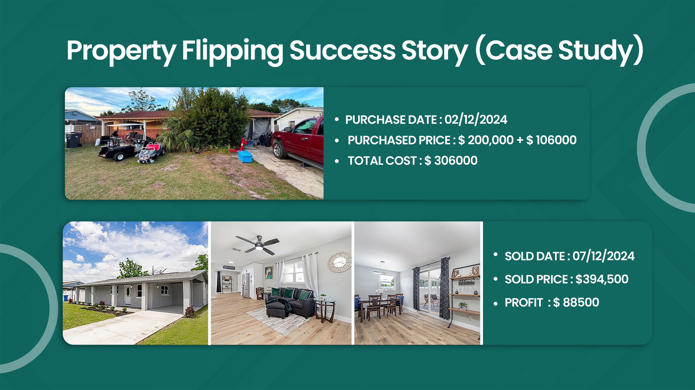

Slide 9
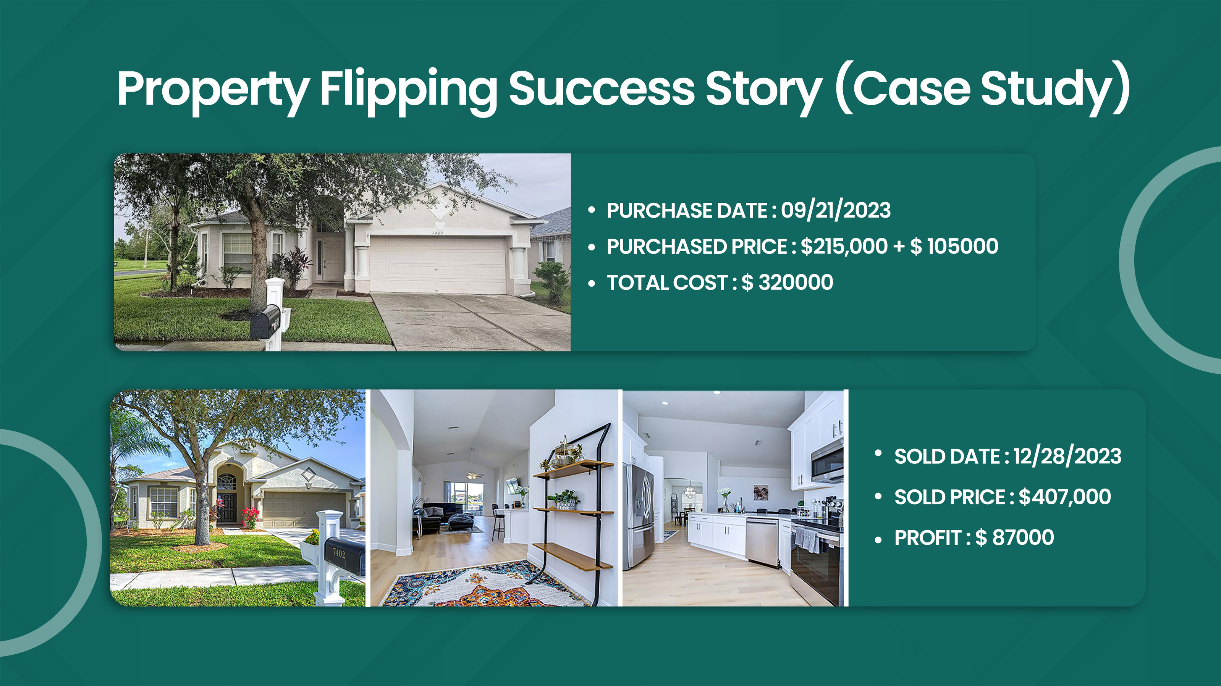

Slide 10


Investment vs. Bank Returns
Real Estate Investment vs. Traditional Savings
Bank Return: ~5% annually (capital stagnant).
Real Estate Return: High immediate profits,
growing property value annually.
Example projection: Investing $100K could
significantly multiply over 10-20 years.

Slide 11


Reliable Backup Plan: Renting
Secure Your Investment with a Solid Plan B
Rental income exceeds typical bank interest.
Florida’s landlord-friendly regulations.
Long-term value appreciation ensures growth.

Slide 12
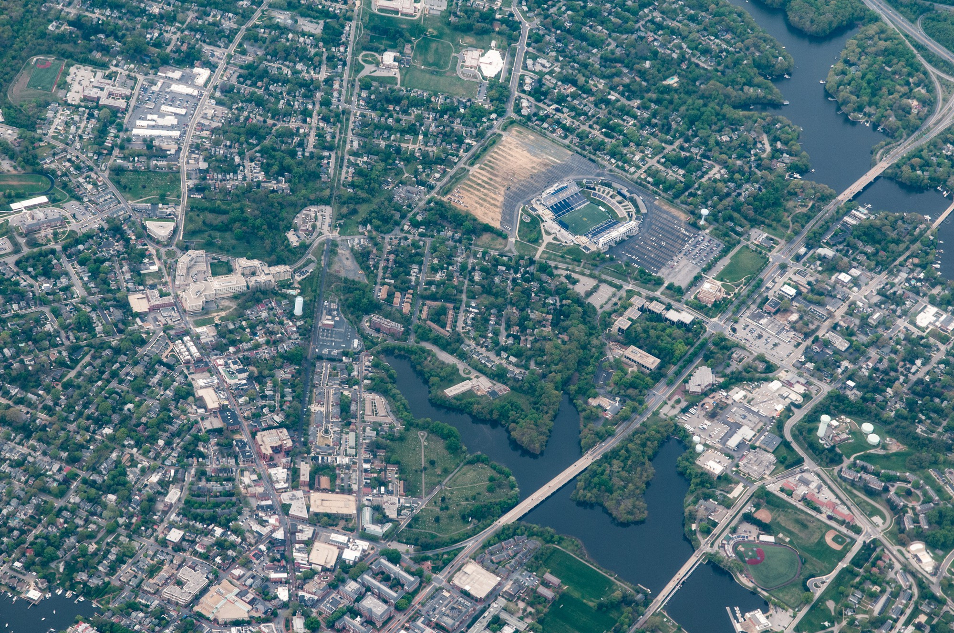



Why Choose Florida?
Landlord-friendly policies.
Continuous property value growth.
Strong rental demand,
stable market.

Slide 13

Transparency and Trust
Clear, open communication throughout.
Proven track record in successful flipping projects.
Full visibility into project costs and progress.

Slide 14


Turning $55K into $5M:
My Personal Investment Journey
Started with just $55,000 in 2012 after moving to Florida
Flipped and rented multiple properties across Zephyrhills, Port Richey & Seffner
Over 10 successful deals, each multiplying initial investments
Achieved a total asset value of $5 Million+ across:
  Sunstate Investment Company – $2M
  Thovi LLC – $1.7M (started with $300k in 2021)
  Sunshine Ranch – $1M (started with $500k in 2022)
  Remaining equity from rental/flip gains – $700K+
Consistently turned properties bought under $100K into
assets worth 200%–400% more
Maintains ongoing rental income while continuing flips

Slide 15
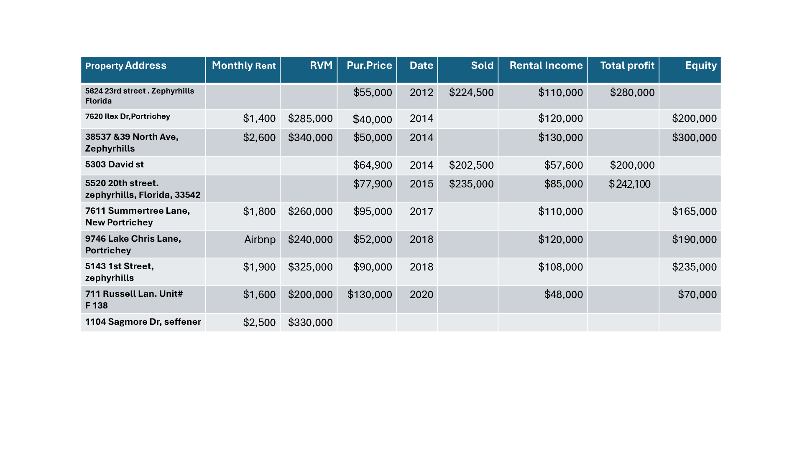

Slide 16
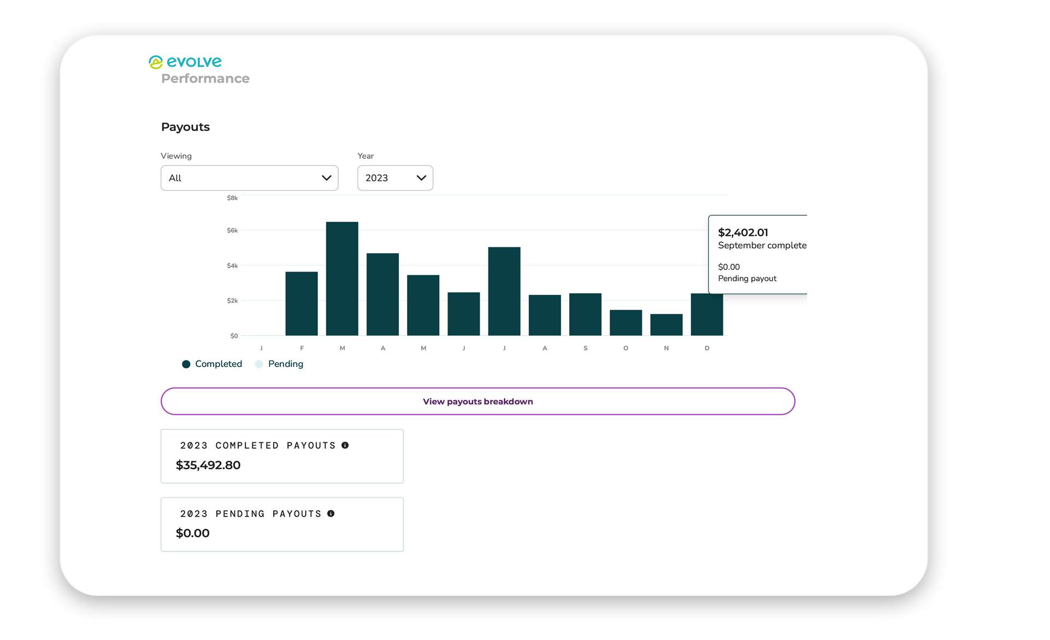

9746 Lake Chris Lane:
A Case Study in Airbnb Profitability
2023

Slide 17
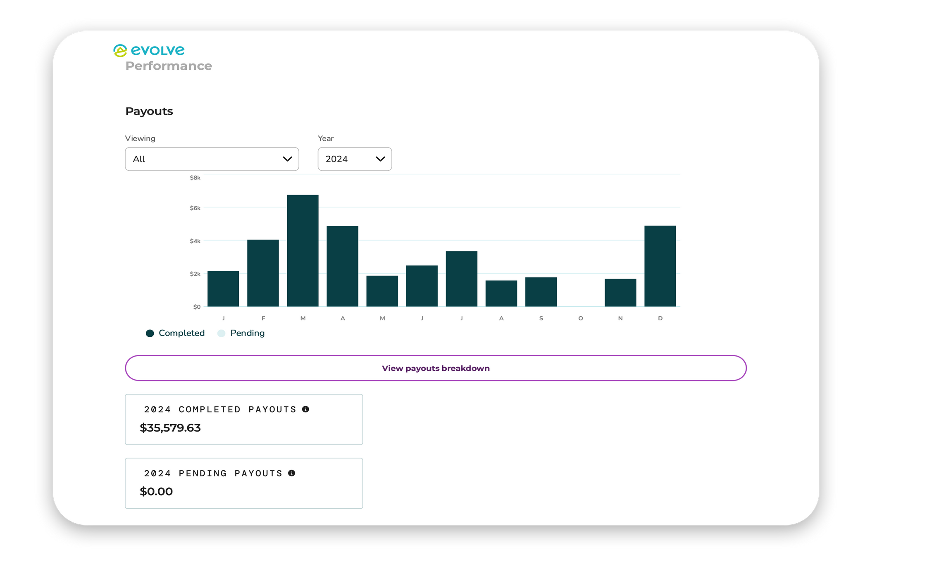
2024

Slide 18
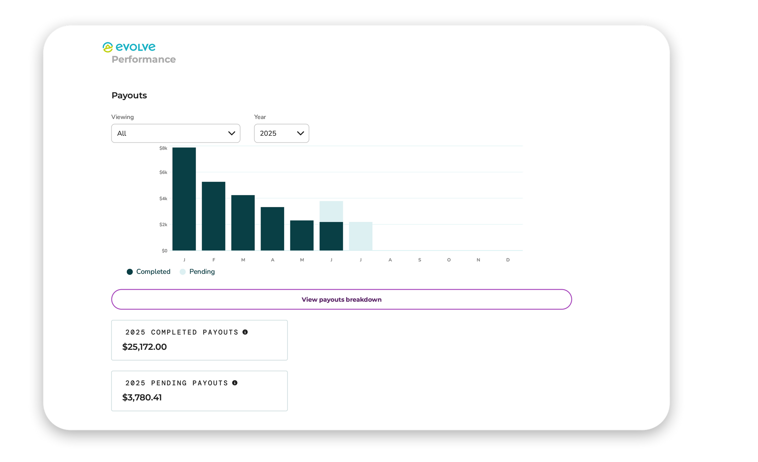
2025

Slide 19




Let’s Flip Properties Together!
Easy investment process, high returns, minimal risks.
Proven methodology, expert management,
full transparency.
+1 (813) 312-1298
realtorthomas05@gmail.com

